Slide 1
Florida’s Tort Reform
FLORIDA OFFICE OF INSURANCE REGULATION
Commissioner Michael Yaworsky
March 2025

Slide 2
Property Insurance Market Highlights
Data as of November 1, 2024.
7.58 M
Residential
1.2 M
Policies
Insurance
Policies
in Force
Approved for
Takeout in
2024
$3.8 T
Total Insured Value
*excluding auto

Slide 3
How Did We Get Here?
Inflation
Litigation
Storms
Reinsurance

Slide 4
Legislative Reform
Senate Bill 7052 (2023) enacted consumer protections intended to support Florida’s policyholders following a disaster and strengthened OIR’s regulatory authority.
House Bill 837 (2023) modified the bad faith framework, eliminated one way attorney’s fees and fee multipliers and ensured that Floridians can’t be held liable for damages if the person suing is more at fault.
House Bill 799 (2023) required OIR to conduct a wind-loss mitigation study to determine how to include wind uplift prevention to the list of windstorm mitigation measures for purposes of policyholder mitigation discounts.
Senate Bill 2-D (2022) enacted pro-consumer measures to help alleviate rising insurance costs, to increase insurance claim transparency, and to crack down on frivolous lawsuits.
Senate Bill 2-A (2022) eliminated one-way attorney fees for property insurance, strengthened the regulatory authority of OIR, established a new optional state reinsurance program, and required insurers to more promptly communicate, investigate, and pay valid claims.

Slide 5
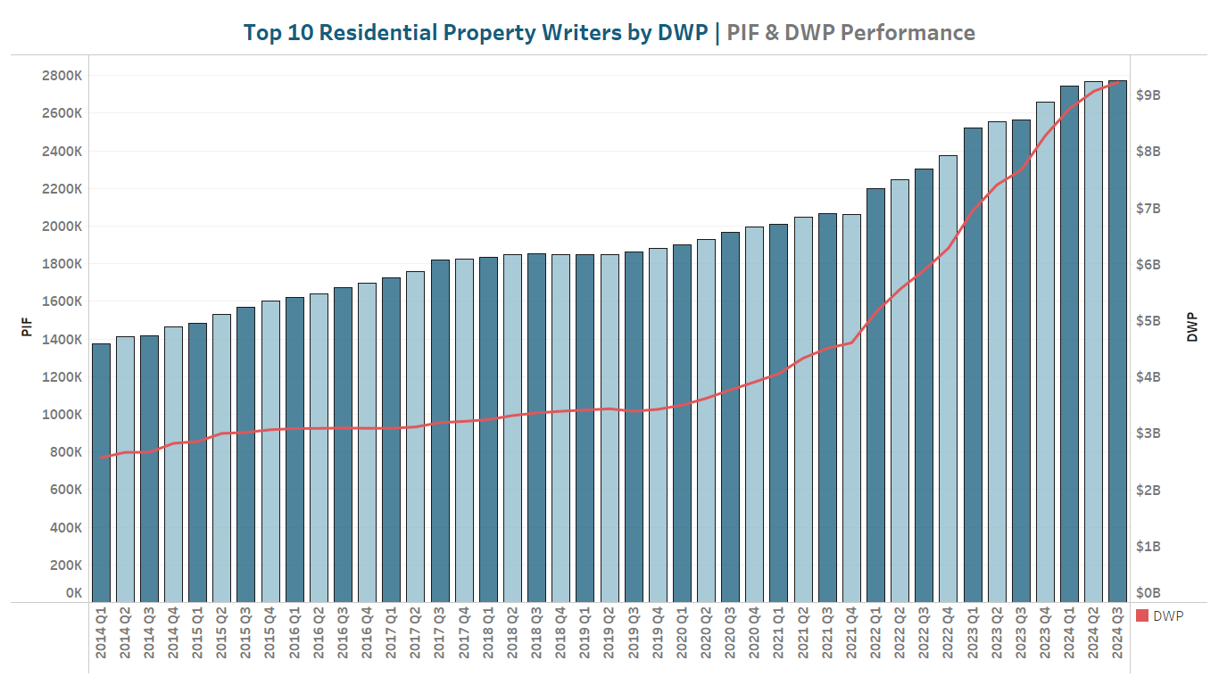
The Outcome

Slide 6
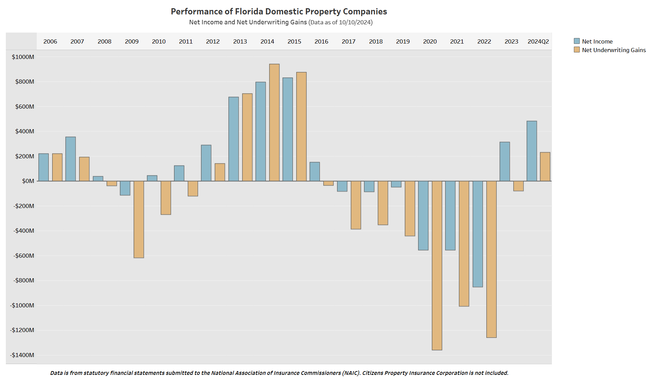
The Outcome: Industry Performance

Slide 7
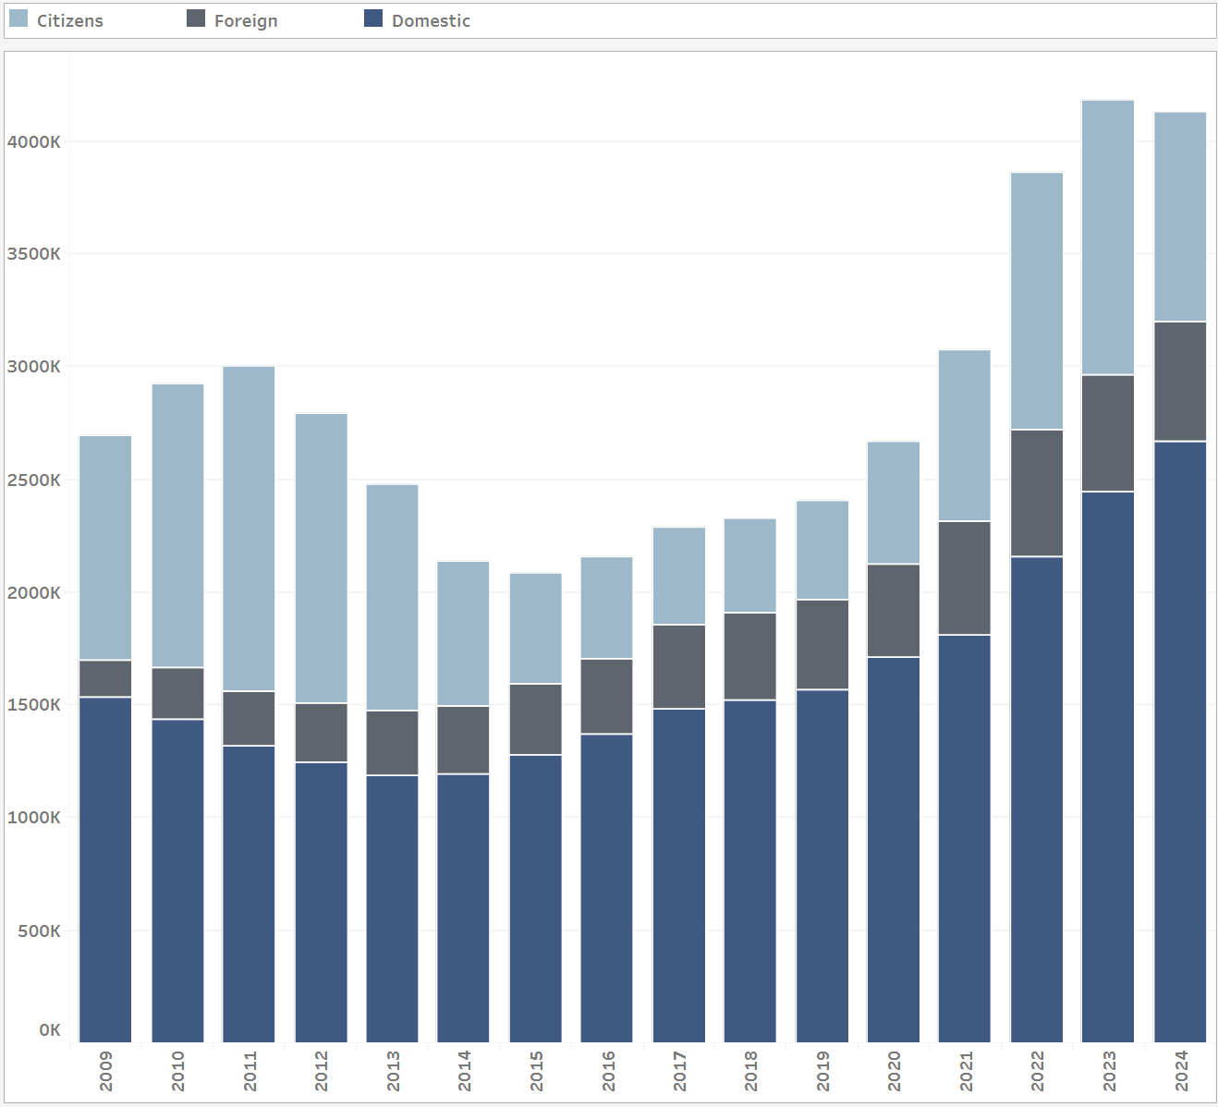
The Outcome: Top 10 Residential Property Writers by PIF
Citizens PIF 19% from 2022 2024
Admitted Carriers in Top 10 PIF 18% from 2022 2024

Slide 8
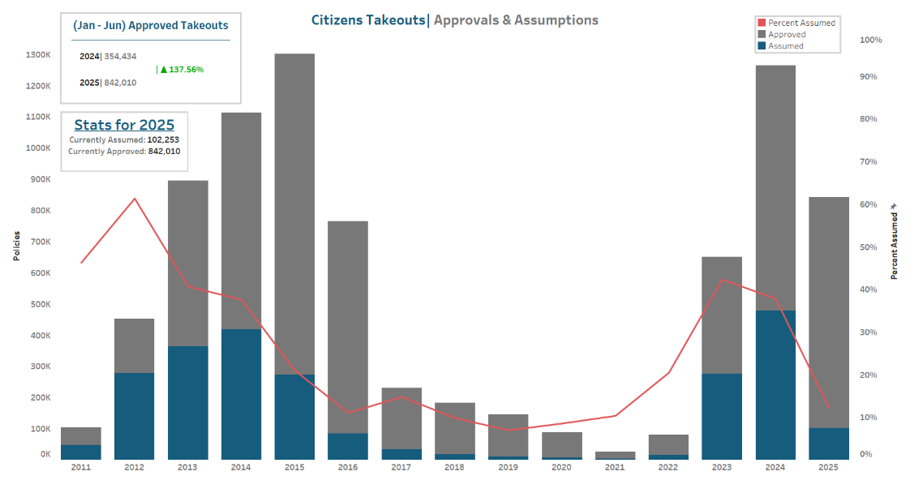
The Outcome

Slide 9
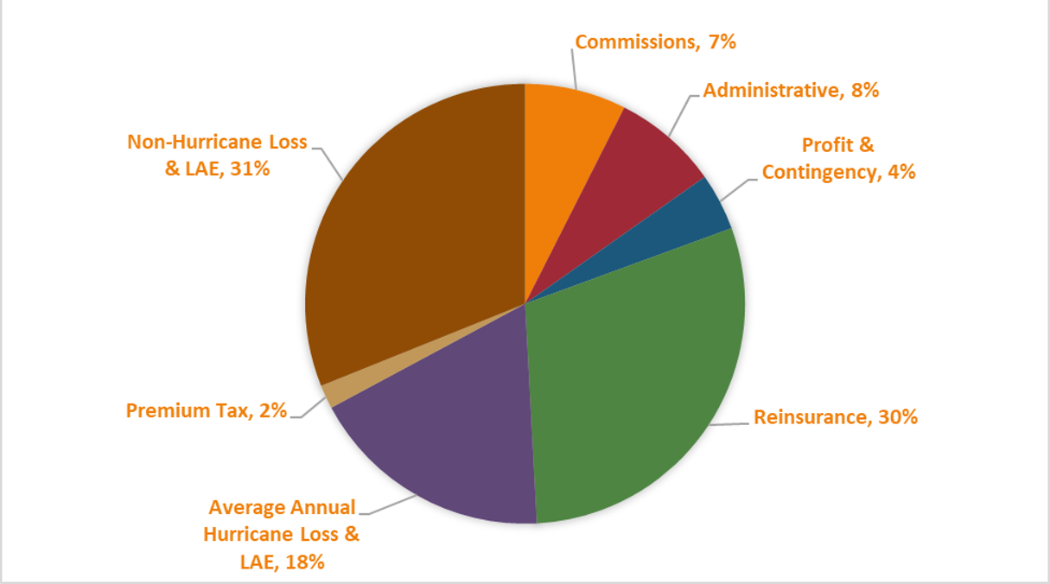
Rate Calculation Breakdown

Slide 10
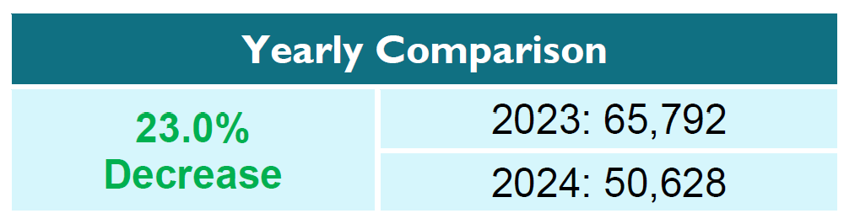
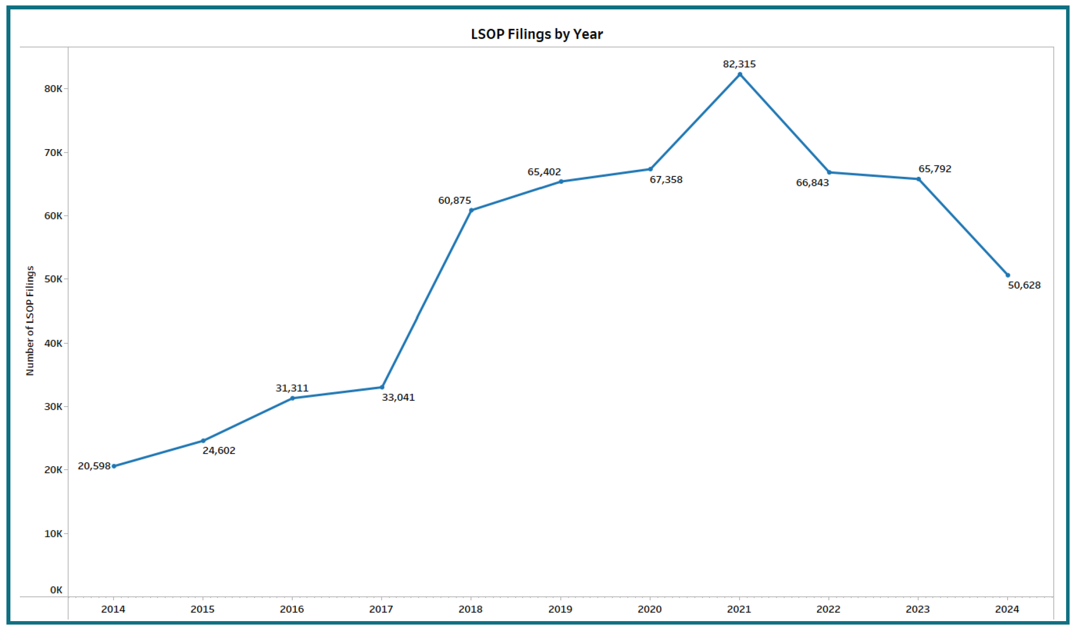
The Outcome: Legal Service of Process (LSOP)
Lowest # of LSOPs filed since 2017

Slide 11

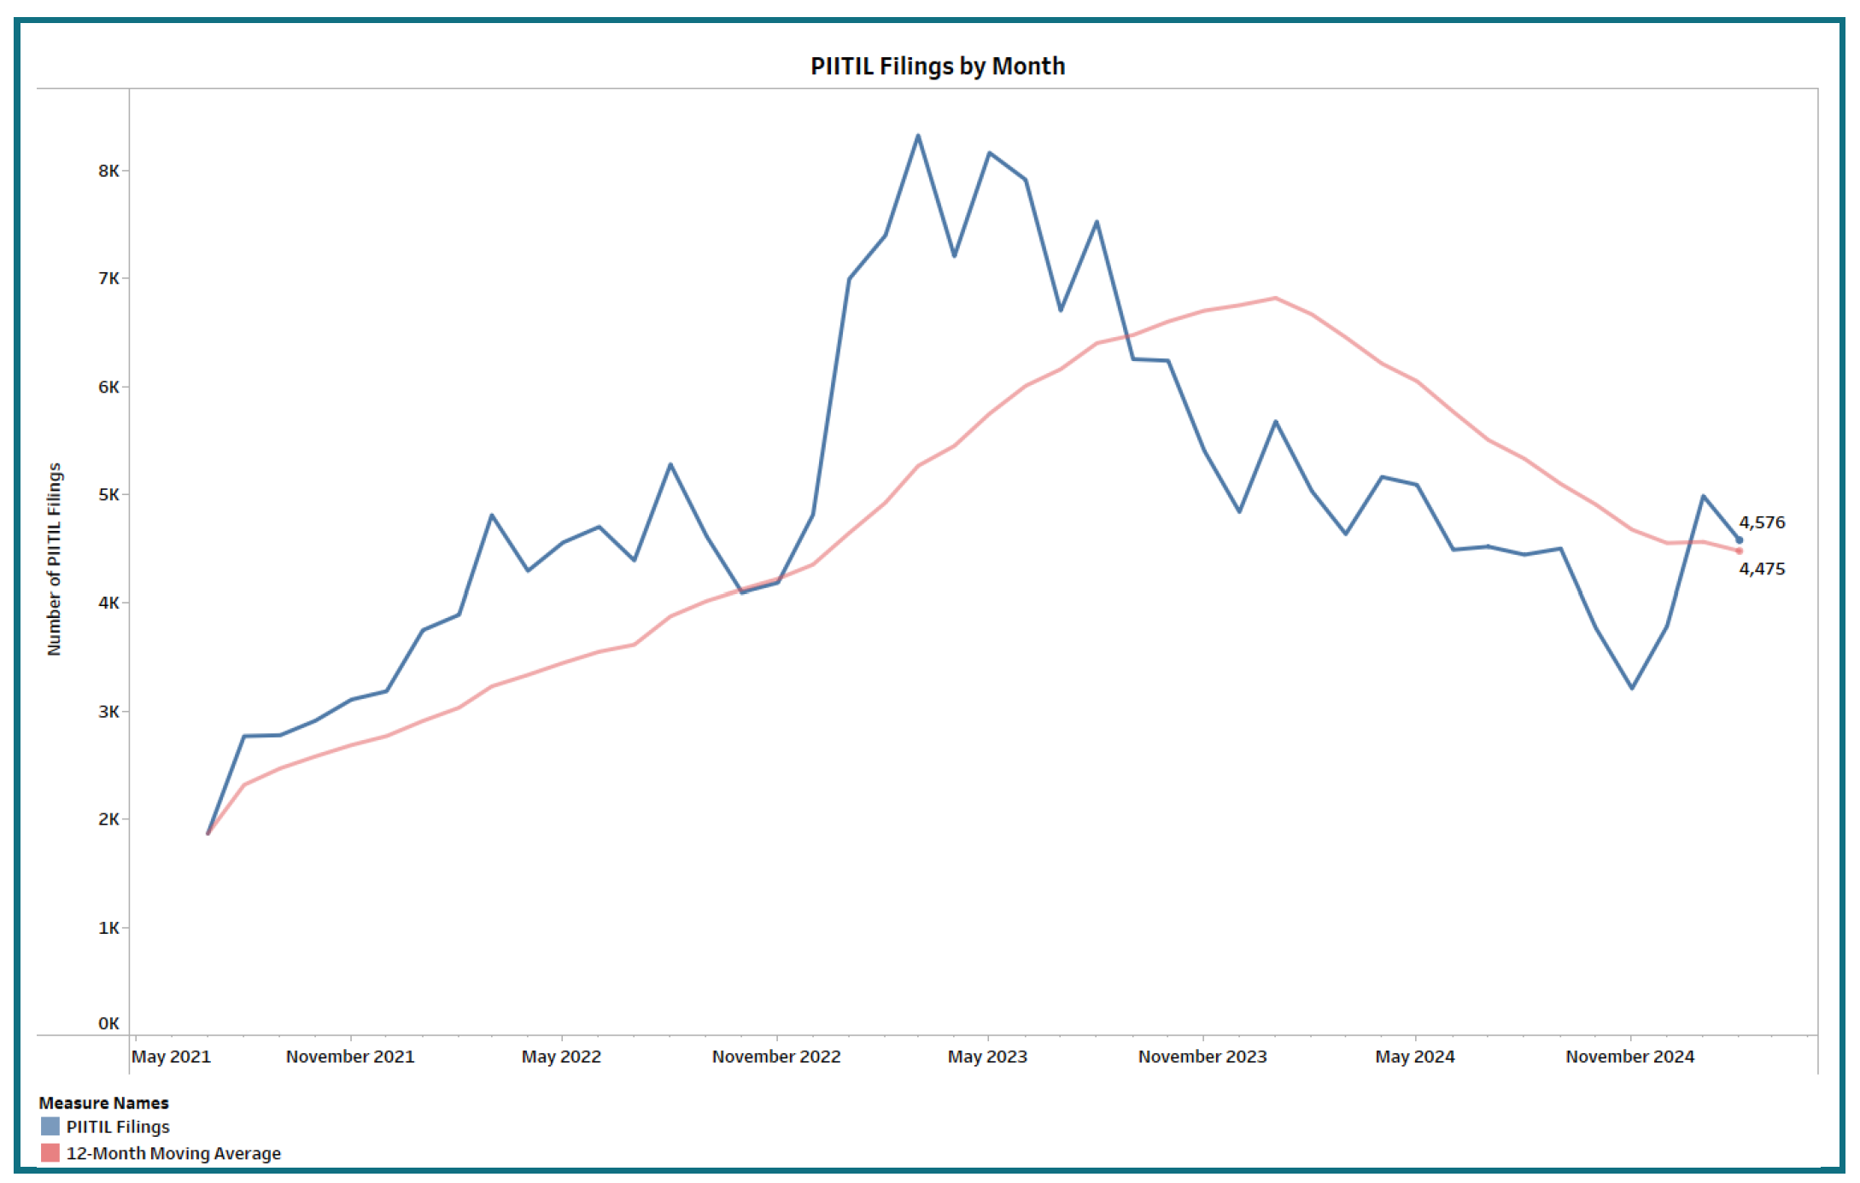
The Outcome: Property Insurance Intent to Initiate Litigation (PIITIL)

Slide 12
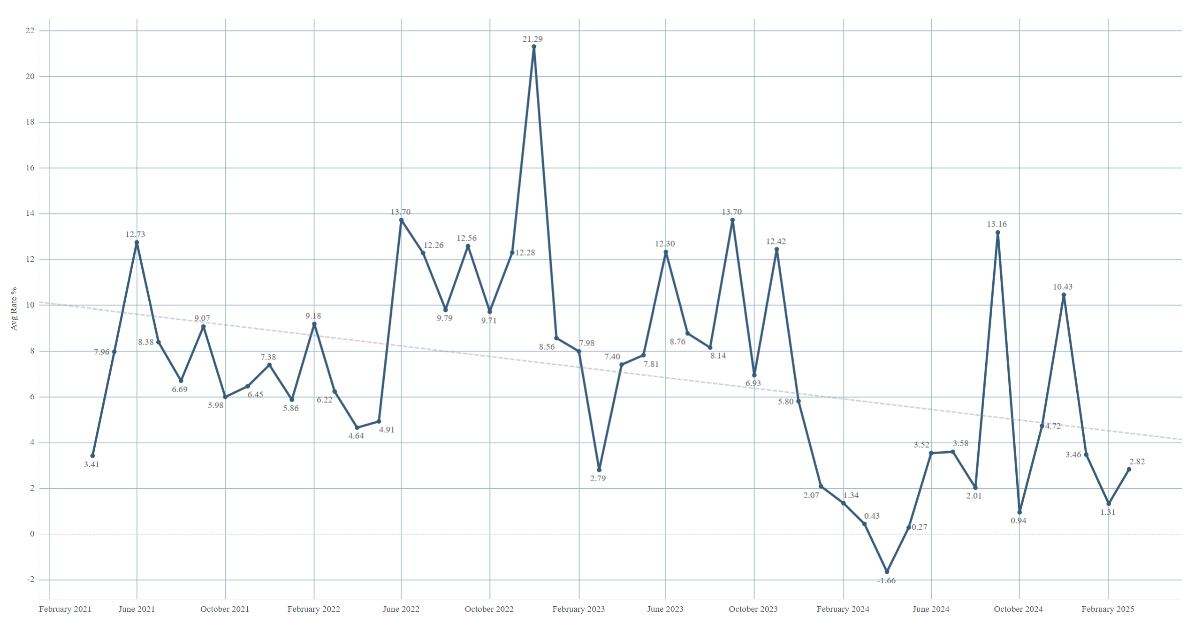
The Outcome: Approved Personal Residential Property Average Rates (Excluding Citizens)
Effective December 2022, average approved rates were +21.29%.
Effective March 2025, average approved rates were +2.82%.

Slide 13
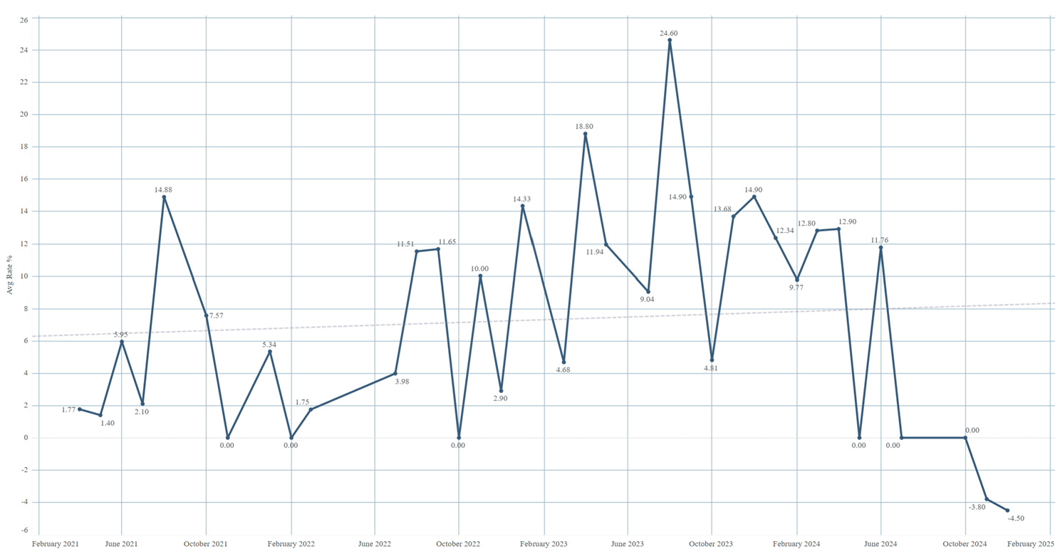
The Outcome: Approved Mobile Home Multi-Peril Average Rates
Effective January 2023, average approved rates were +14.33%.
Effective December 2024, average approved rates were
-4.50%.

Slide 14
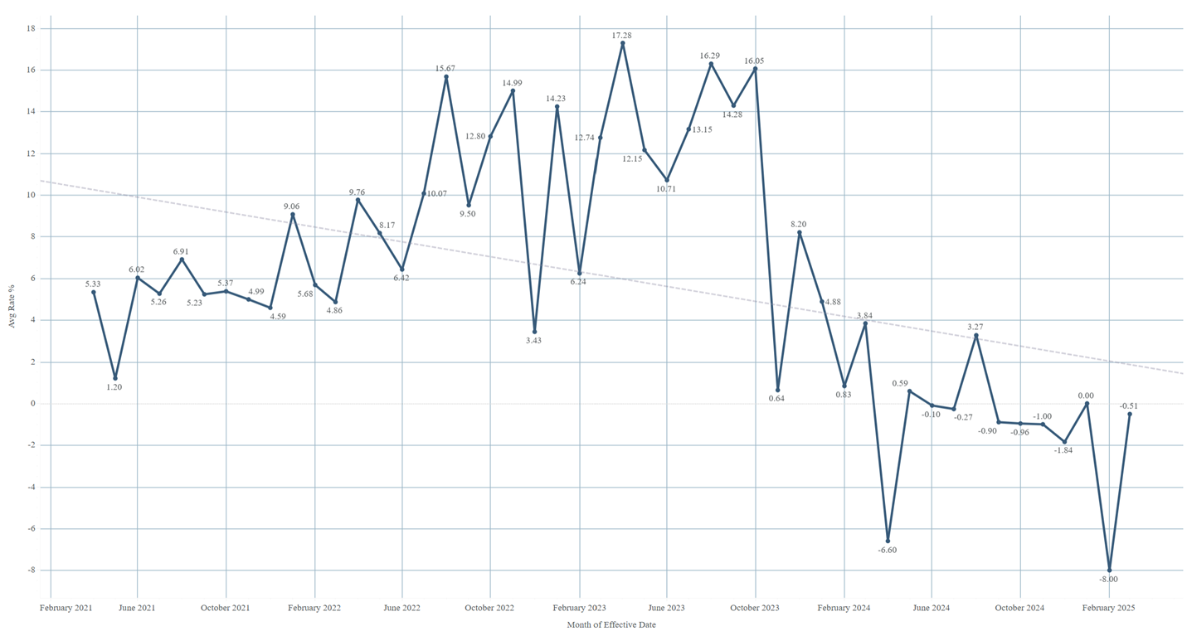
The Outcome: Approved Private Passenger (Autos Only) Average Rates
Effective January 2023, average approved rates were +14.23%.
Effective March 2025, average approved rates were -0.51%.

Slide 15
The Outcome:
Following these historic legislative reforms to strengthen Florida’s insurance market, OIR has approved eleven additional property & casualty insurers to enter Florida’s market.
Property Claims Life Cycle Report (PCLR)
  Non-catastrophe claims reduced (-7.26%) from 2022 to 2023.
  Total loss adjustment expenses (LAE) paid for claims closed in 2023: $1.9 Billion

Slide 16
Contact Information
Kevin Jacobs, Chief of Staff
Kevin.Jacobs@floir.com
(850) 413-5011
Seth Stubbs, Director of Legislative and Cabinet Affairs
Seth.Stubbs@floir.com
(850) 413-2427
For more information visit www.floir.com.

Slide 17

Florida Office of Insurance Regulation
Notes:
CONCLUSION
As we all adjust and respond to COVID-19, OIR is currently working with the industry regarding filing requirements and other important business processes.
OIR believes companies should focused on best serving Floridians. Our goal is to home in on what we truly need from a regulatory standpoint so insurers can focus on their policyholders during this time.
Thank you again for allowing me to present today. I want to reiterate my gratitude to the Governor and Florida Cabinet for their leadership.

